Slide 1
GAR
Session 05: Super Mario Bros

Slide 2
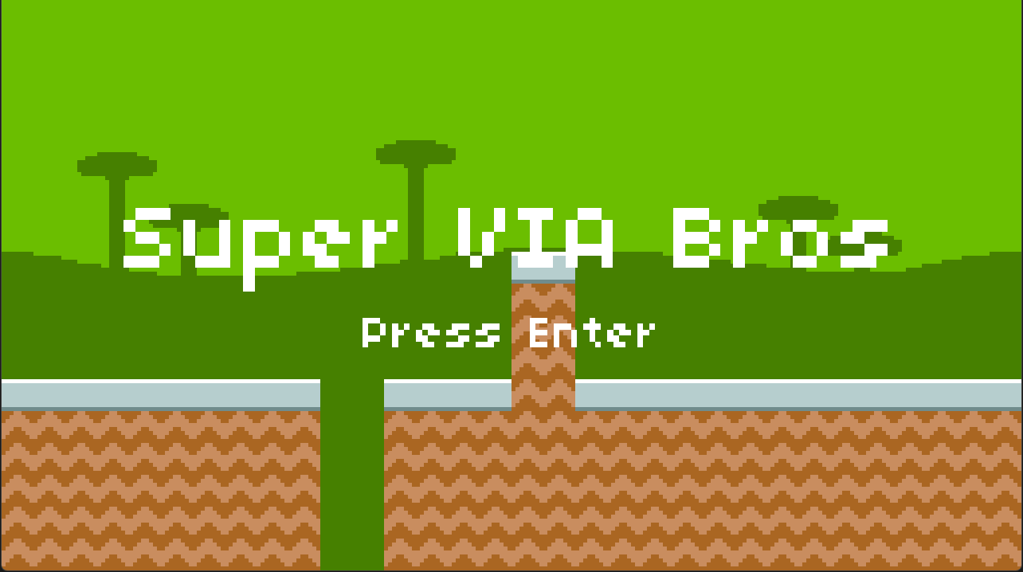
Today’s Goal

Slide 3
Today’s Topics
Procedural Level Generation
State Pattern
Camera
Platformer Physics
Basic AI
Powerups

Slide 4
Source Code
All Source code for today’s game can be found here:
  https://github.com/Metamate/gmd2-platformer
The game is built up in steps: Platformer0 → Platformer8
  Each step is a separate project that adds one concept
  Compare neighbouring steps to see exactly what changed
Platformer8 is the finished game, and the starting point for the exercises

Slide 5
Level Generation
<Tilemap>
<Tileset region="0 40 80 80" tileWidth="20" tileHeight="20">images/atlas</Tileset>
<Tiles>
00 01 02 01 03
04 05 06 05 07
08 09 10 09 11
04 09 09 09 07
12 13 14 13 15
</Tiles>
</Tilemap>
00 01 02 01 03
04 05 06 05 07
08 09 10 09 11
04 09 09 09 07
12 13 14 13 15

Slide 6
Procedural Level Generation
public Tilemap Generate(int columns, int rows)
{
tilemap = new(Tileset, columns, rows);
int groundHeight = 2;
for (int x = 0; x < columns; x++)
{
for (int y = 0; y < Tilemap.Rows; y++)
{
if (y >= Tilemap.Rows - groundHeight)
{
Tilemap.SetTile(x, y, 1);
}
}
}
return tilemap;
}
00 00 00 00 00
00 00 00 00 00
00 00 00 00 00
01 01 01 01 01
01 01 01 01 01

Slide 7
Tilemap Update
Tilemap up until now have been an array of integer ids
  Each pointing to an index in the Tileset (i.e. TextureRegion)
Now it is an array of Tiles
  Why?
  Our tilemap is getting smarter!
  We need to store more information than just the tile graphic!

Slide 8
Tile
public readonly struct Tile(int graphicId = -1, int topperId = -1, bool isSolid = false)
{
public static readonly Tile Empty = new();
public int GraphicId { get; init; } = graphicId;
public int TopperId { get; init; } = topperId;
public bool IsSolid { get; init; } = isSolid;
public bool HasTopper => TopperId >= 0;
public Tile() : this(-1, -1, false) { }
public Tile(int graphicId, bool isSolid) : this(graphicId, -1, isSolid) { }
}

Slide 9

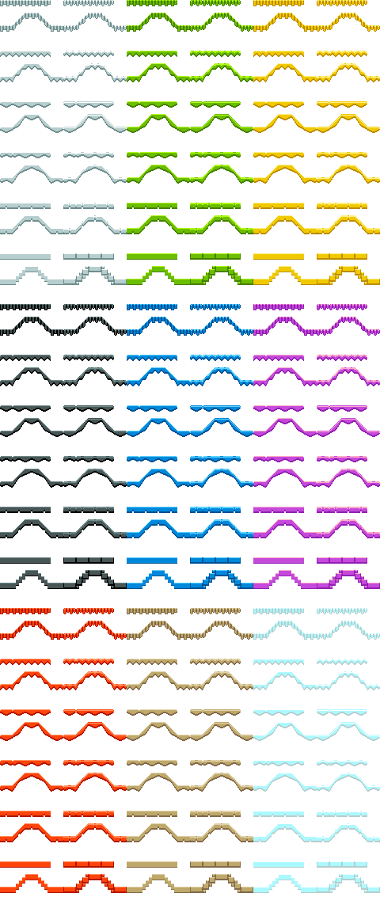
Tilesets

Slide 10
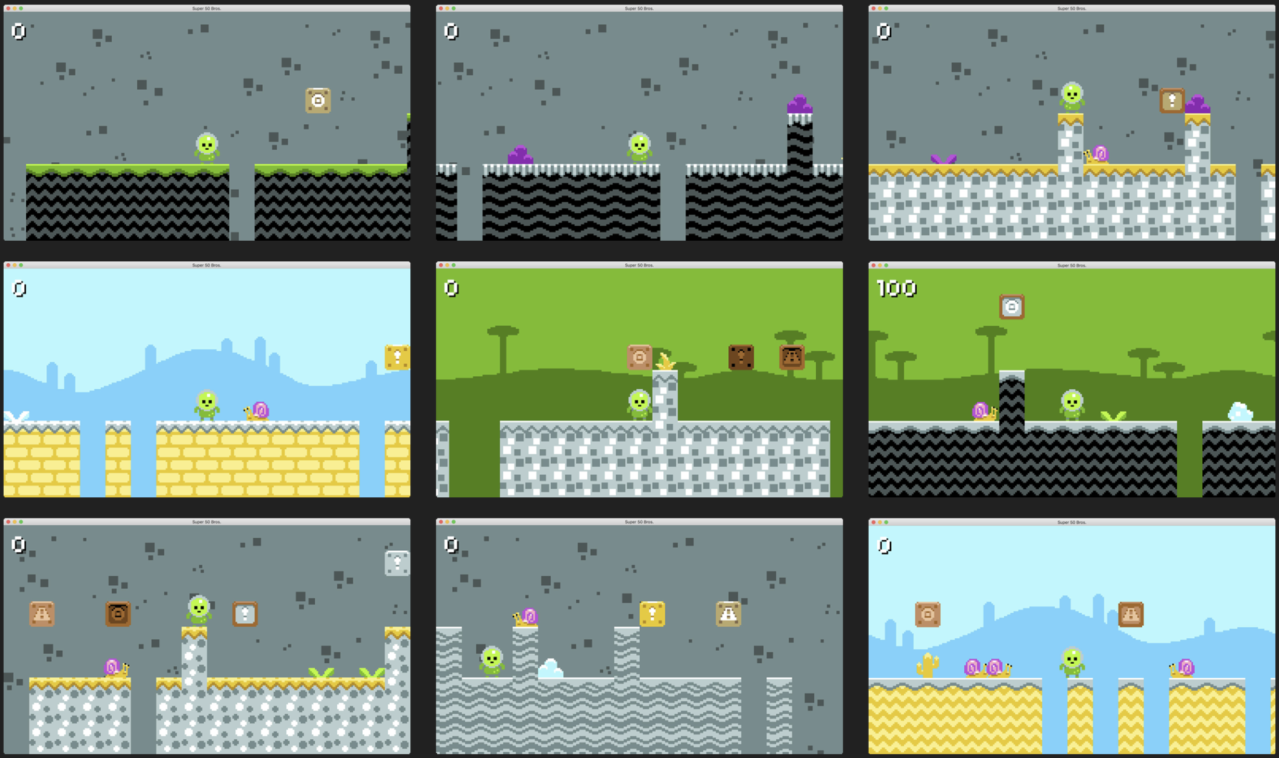
GameLevel

Slide 11
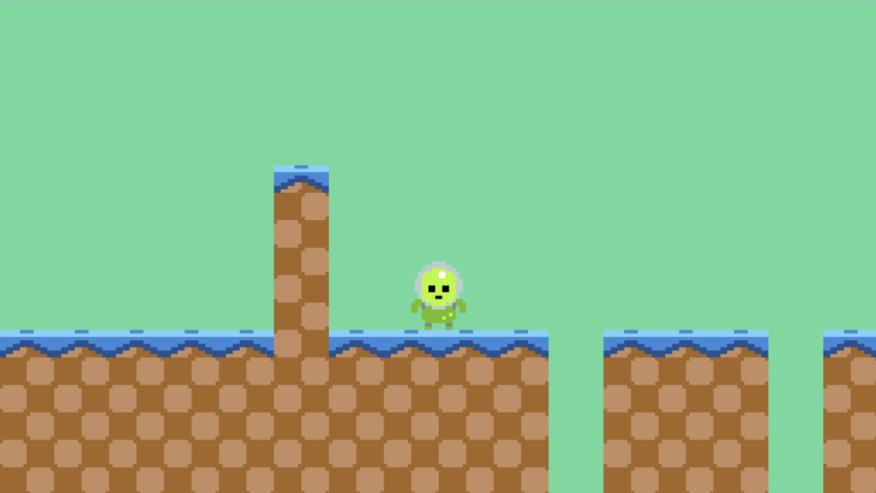
LevelMaker
LevelMakerBase
SimpleLevelMaker
FlatLevelMaker
PillarLevelMaker
PitlevelMaker
ComplexLevelMaker
(This is essentially the strategy design pattern)

Slide 12
LevelMaker Implementation
DEMO!
Platformer0 → Platformer1: tilemaps from code and level makers

Slide 13
Character State
void Heroine::handleInput(Input input)
{
if (input == PRESS_B)
{
if (!isJumping_ && !isDucking_)
{
// Jump...
}
}
else if (input == PRESS_DOWN)
{
if (!isJumping_)
{
isDucking_ = true;
setGraphics(IMAGE_DUCK);
}
else
{
isJumping_ = false;
setGraphics(IMAGE_DIVE);
}
}
else if (input == RELEASE_DOWN)
{
if (isDucking_)
{
// Stand...
}
}
}
What is the problem with this code?
  The way state is encoded, you can end up in illegal states!
Can you spot the bug?
  We check that you can’t air jump while jumping, but not while diving
    Yet another field… (isDiving)

Slide 14
Character State - Enum Solution
void Heroine::handleInput(Input input)
{
switch (state_)
{
case STATE_STANDING:
if (input == PRESS_B)
{
state_ = STATE_JUMPING;
yVelocity_ = JUMP_VELOCITY;
setGraphics(IMAGE_JUMP);
}
else if (input == PRESS_DOWN)
{
state_ = STATE_DUCKING;
setGraphics(IMAGE_DUCK);
}
break;
case STATE_JUMPING:
if (input == PRESS_DOWN)
{
state_ = STATE_DIVING;
setGraphics(IMAGE_DIVE);
}
break;
case STATE_DUCKING:
if (input == RELEASE_DOWN)
{
state_ = STATE_STANDING;
setGraphics(IMAGE_STAND);
}
break;
}
}
Why is this better?
  You can’t encode invalid state!
Why is it still (potentially) problematic?
  What if states have state?
    E.g. a charge attack while ducking!
  Doesn’t scale well…

Slide 15
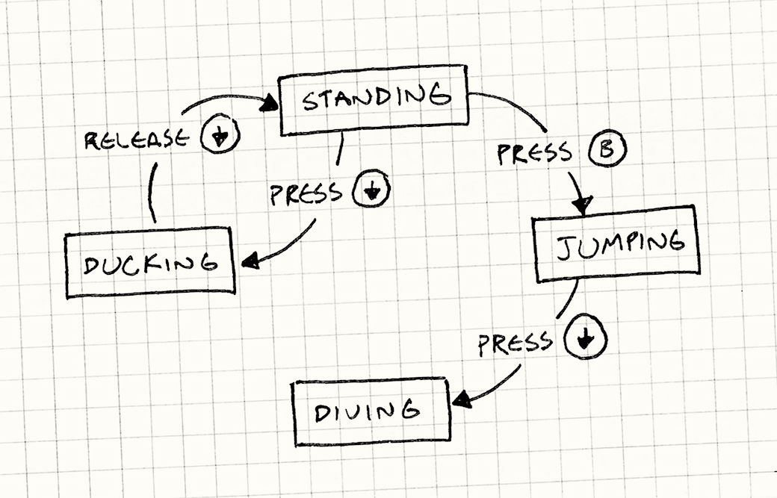
State Pattern
Allows an object to change its behaviour based on an internal state
State-specific behavior is defined independently
  Adding new states does not impact the behavior of existing states
Notes:
Hierarchical state machines, stack-based state machines, pushdown automata

Slide 16
Player State Implementation
DEMO!
Platformer2 → Platformer3: from an enum to the State pattern

Slide 17
Game State Implementation
DEMO!
Platformer5: title and play states

Slide 18
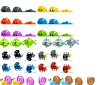
Snail States (Aka Basic AI)
Base
  Handles collision detection and resolution, gravity, ground detection
Idle
  Starting state, plays idle animation (duration)
Move
  Moves around, reverses at edge or when velocity.x = 0
Chase
  Moves towards player on x.axis

Slide 19
Snail State Implementation
DEMO!
Platformer7: snail AI
Notes:
Notice new Play() method of AnimatedSprite for swapping animation
Duplicate collision detection logic between snail and player
Any ideas on how we could fix this?
The component design pattern!

Slide 20

Camera
Why do we need a camera now and not for the previous games?
Performs two matrix translations based on target pos
  Shift world + Center
In this game we only need tracking on the x-axis
Gets clamped playerX
  Based on tilemap dimensions

Slide 21
Camera Implementation
DEMO!
Platformer4: camera and a wide level

Slide 22

Input
We now have a GameController class that abstracts away hardcoded keys for “actions”
This is NOT the Command Pattern!
  why not?

Slide 23

Player Hitbox
Player is same width as tiles, this makes it hard to fall down pits
  The player can run across a pit without falling down!
We shrink the hitbox/collider with 2px on each side
  Now you gotta jump those pits!

Slide 24
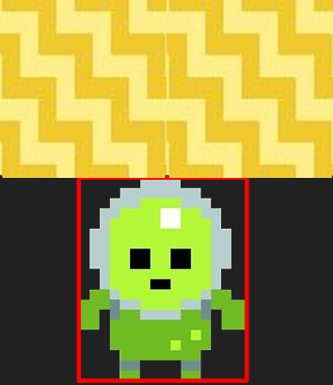

Tile Collision (up/down)
Notes:
Two checks (per direction)
Small inset to allow jumping/falling next to solid tiles (otherwise could be problematic due to floating point precision)

Slide 25
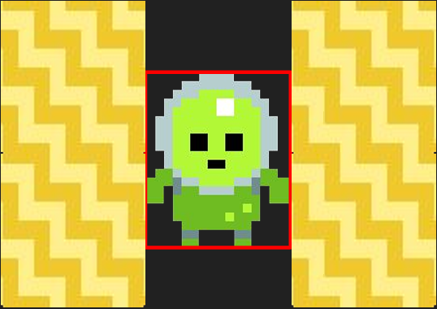
Tile Collision (left/right)
Notes:
Inset to avoid getting stuck in the ground and tiles right above the player

Slide 26
Collision Response
private void SnapToRight(float x)
{
Player.Position = new Vector2(x - Player.Sprite.Width + Player.HitboxInset, Player.Position.Y);
Player.Velocity = new Vector2(0, Player.Velocity.Y);
}
private void SnapToLeft(float x)
{
Player.Position = new Vector2(x - Player.HitboxInset, Player.Position.Y);
Player.Velocity = new Vector2(0, Player.Velocity.Y);
}
private void SnapToBottom(float y)
{
Player.Position = new Vector2(Player.Position.X, y - Player.Sprite.Height);
Player.Velocity = new Vector2(Player.Velocity.X, 0);
}
private void SnapToTop(float y)
{
Player.Position = new Vector2(Player.Position.X, y);
Player.Velocity = new Vector2(Player.Velocity.X, 0);
}

Slide 27
IsOnGround
protected bool IsOnGround()
{
Rectangle hitbox = Player.Bounds;
// Check Tilemap
bool onTile = Player.Tilemap.IsSolidAt(hitbox.Left + CollisionInset, hitbox.Bottom + 1) ||
Player.Tilemap.IsSolidAt(hitbox.Right - CollisionInset, hitbox.Bottom + 1);
if (onTile) return true;
// Check solid Entities
Rectangle sensor = ExpandDirectional(hitbox, 0, 1);
return Player.Level.Entities.Any(e => e.Active && e.IsSolid && e.Collidable && sensor.Intersects(e.Bounds));
}

Slide 28
Tilemap Additions
public Tile PointToTile(Vector2 point)
public Vector2 TileToPoint(int column, int row)
public bool IsSolidAt(float x, float y)
public float GetTileLeft(float x)
public float GetTileRight(float x)
public float GetTileTop(float y)
public float GetTileBottom(float y)
private Tile? GetTileAt(float x, float y)

Slide 29
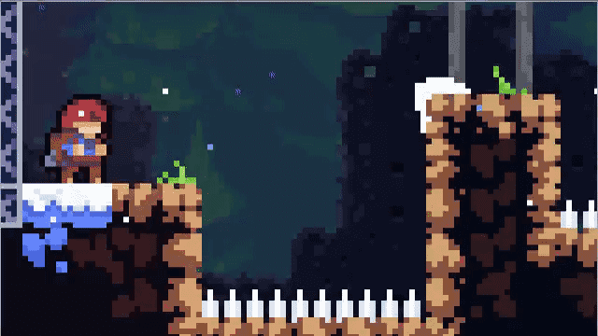

Coyote Time

Slide 30
Platformer Physics Performance
Do we need collision checks between the player and every single tile?
  No! The grid is static!
  It is a simple “lookup” - it takes the same time in a level of 10 or 10.000 tiles
  O(n) → O(1)
public bool IsSolidAt(float x, float y)
{
return GetTileAt(x, y)?.IsSolid ?? false;
}
In our game we are only checking collisions between the player and other entities
  O(n)
If we naively checked collisions between all entities in our game we risk O(n²)
  n * (n - 1) / 2

Slide 31
Platformer Physics Implementation
DEMO!
Platformer2: gravity, tile collision and coyote time

Slide 32











Entitites
Represent any “thing” in our game
  Player, Snail, Boxes, Powerups, etc.
Separate from the tiles in our map
  Entities may not align perfectly with the tilemap
Can contain states just like the game
  States can affect input handling (e.g. player) or decision-making (e.g. snail)
Some engines may adopt an Entity-Component System
  Everything is an Entity
  Entities are containers of components
  Components ultimately drive behavior
  Component Design Pattern!
Notes:
Entities may have different widths/heights or their positions are offset by a different amount than TileSize

Slide 33
Entity
public interface IEntity
{
public Vector2 Position { get; set; }
public Rectangle Bounds { get; }
public bool Collidable { get; set; }
public bool IsSolid { get; }
public bool Active { get; set; }
void Update(GameTime gameTime);
void Draw(SpriteBatch spriteBatch);
bool Collides(IEntity other);
}
We iterate over all entities in the world at the same time
  Made possible by the update method pattern!
Collisions can be done entity-to-entity
  Each entity decides how to handle collisions
  Since entities often move, we cannot do an instant lookup check like for tilemap collisions

Slide 34
Add a Custom Level Maker
Varying ground level and pillar/pit width
Platforms
Multiple types of enemies
A goal flag
  When the player touches the flag at the end of the level, they proceed to the next level
  As the levels are procedural, they can progressively get longer and harder
  Create random keys and locks (same color) that spawn in each level; when the player gets the key, they can unlock the lock, which should spawn the goal flag.

Slide 35
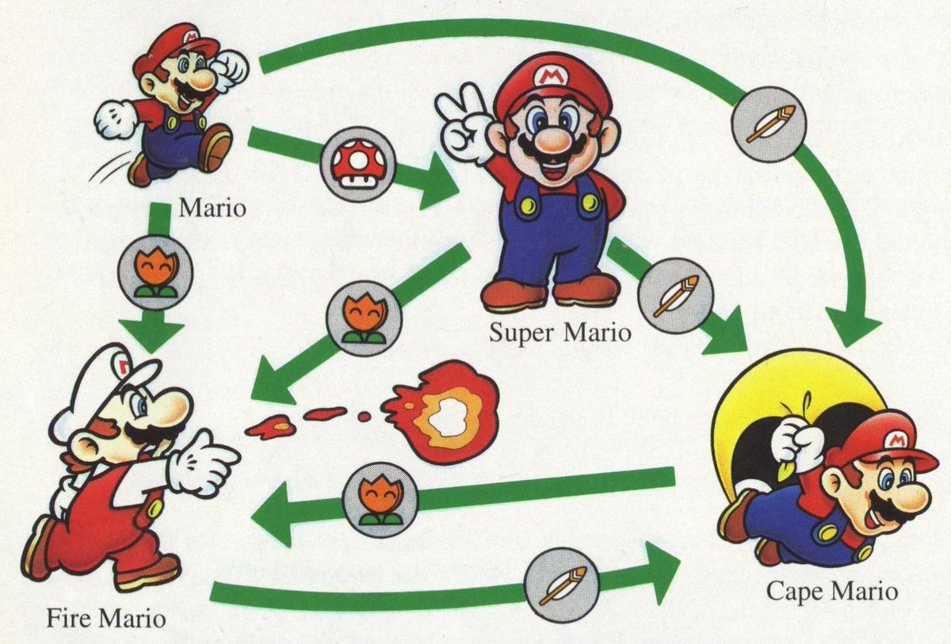
Add Powerups to the Game
Effectively an Entity that changes some state or trait of the player
  A star may flip an “invincible” flag on the player and begin an “invincibleDuration” timer
  A mushroom may trigger a “huge” flag on the player that alters their x, y, width, and height and then scales their sprite

Slide 36
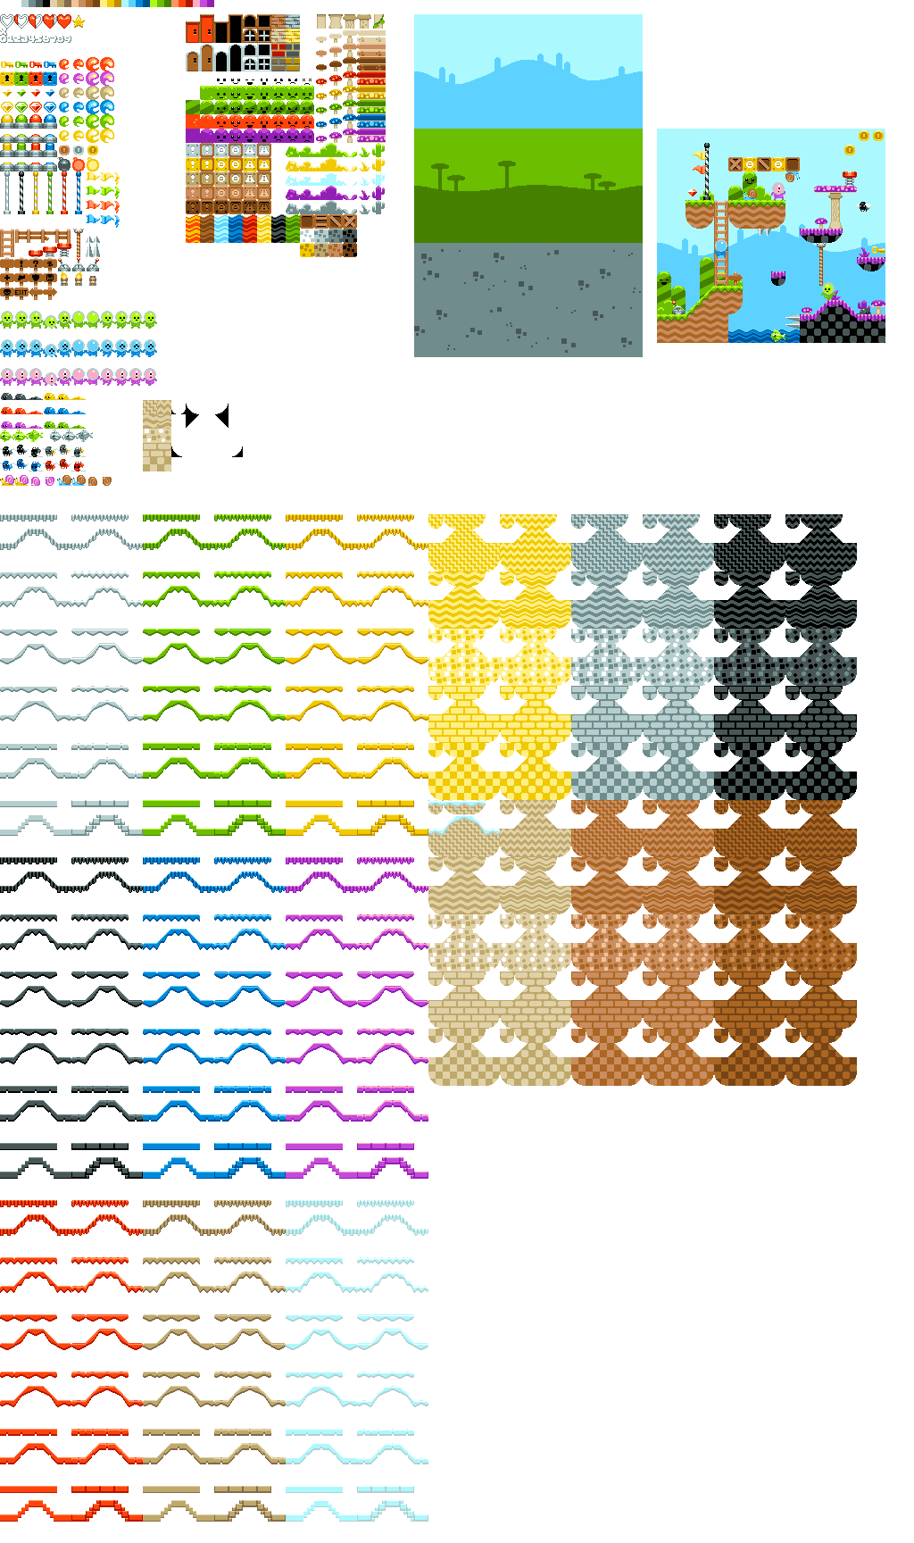
Extra Assets
All assets (sounds/images) available for the platformer

